Slide 1
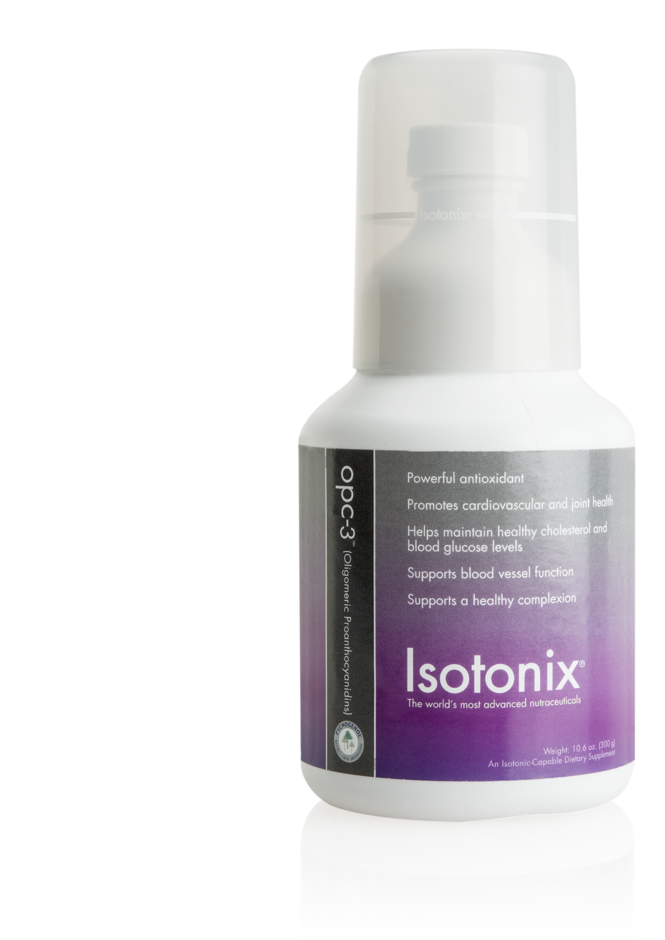
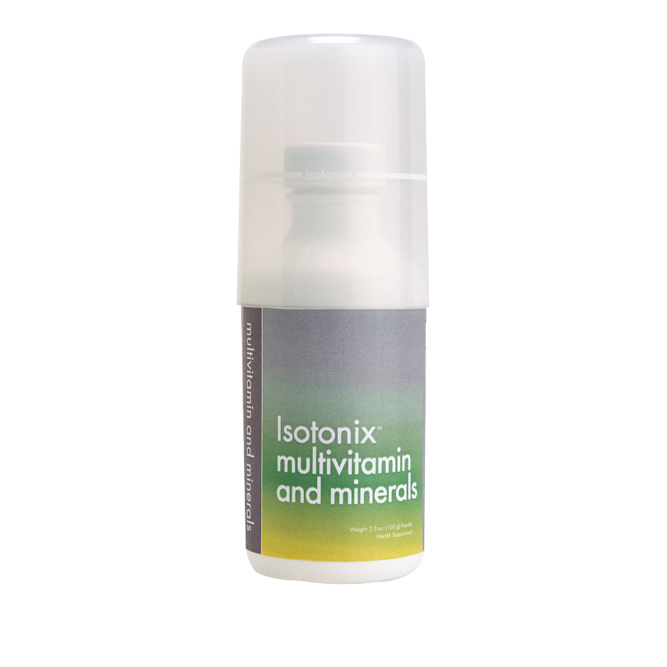
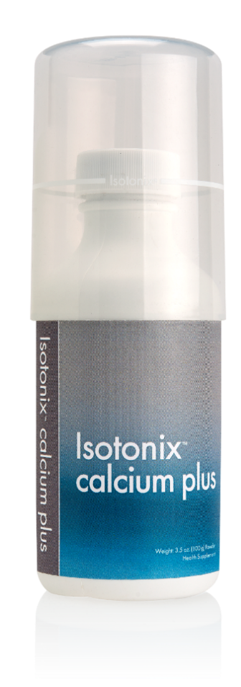
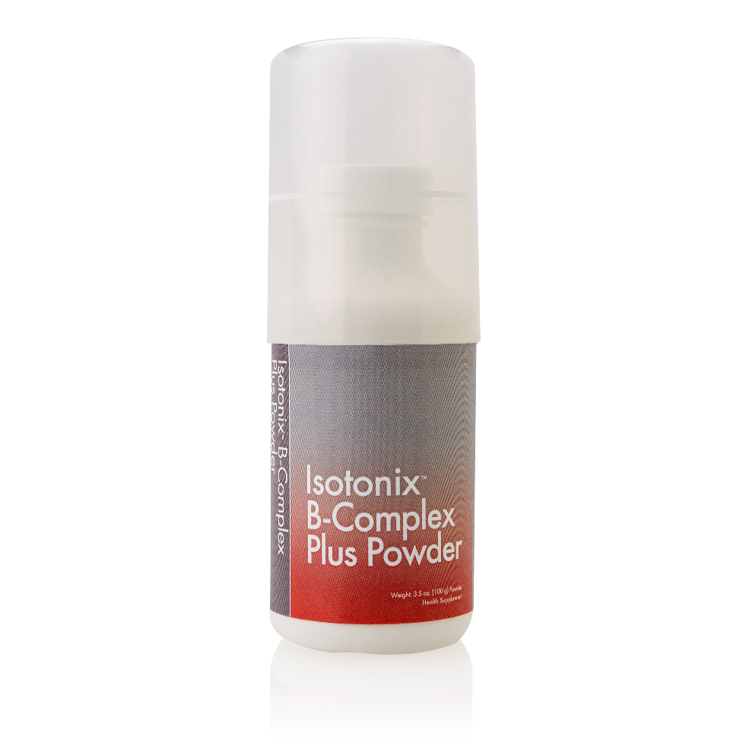
The Isotonix Delivery System
TM
NOTE : These products are not intended to diagnose, treat, cure or prevent any disease.
Isotonix is a registered trademark of Market Singapore in Singapore

Slide 2
The Science of
ISOTONIX
TM

Slide 3

ISO = Similar
TONIC = Pressure
TONICITY = Similar body’s
fluid pressure
Human body’s isotonic state:
280-320 or (270-310)mOsm/Kg
THE MEANING OF
ISOTONIC STATE…
COPYRIGHT2018 MASG. ALL RIGHTS RESERVED.
Notes:
Isotonix dietary supplements are a replica of the body's own fluids such as tears, plasma and breast milk. All fluids in the human body have a certain concentration, which is called the osmotic pressure. The body's common osmotic pressure, which is isotonic, allows a consistent maintenance of all body tissues. In order for a substance to be used in the body's metabolism, it must be changed to the isotonic state.
Isotonic means to have the same pressure as our body’s fluids such as tears, plasma, breast milk.
All fluids in the human body have a certain concentration or osmotic pressure. The body's common osmotic pressure, which is isotonic, allows a consistent maintenance of all body tissues. It allows nutrients to go into cells & waste products to come out of cells. In order for a substance to be used in the body's metabolism, it must be changed to the isotonic state. Isotonix dietary supplements are a replica of the body's own fluids such as tears, plasma and breast milk.
When food is consumed, it will mix with the gastric juice in the stomach. The gastric juice not only helps to digest or break down the food but it also make the food isotonic, so that when the nutrients enter the small intestine, they will be readily & rapidly absorbed into the blood stream.
So always remember this principle: nutrients are most readily & rapidly absorbed in our small intestine into the blood stream when they are in the isotonic state. Such absorption is highly efficient bec very little nutrients is lost. And this is the principle employed in the Isotonix range of supplements

Slide 4
TEARS…
BLOOD PLASMA
ISOTONIC… to have similar osmotic pressure as some of the body’s fluids
Food needs to be digested
• Stomach will mix the food
• Until becomes isotonic state
• Enters small intestine and is absorbed
COPYRIGHT2018 MASG. ALL RIGHTS RESERVED.
Notes:
Isotonix dietary supplements are a replica of the body's own fluids such as tears, plasma and breast milk. All fluids in the human body have a certain concentration, which is called the osmotic pressure. The body's common osmotic pressure, which is isotonic, allows a consistent maintenance of all body tissues. In order for a substance to be used in the body's metabolism, it must be changed to the isotonic state.
Isotonic means to have the same pressure as our body’s fluids such as tears, plasma, breast milk.
All fluids in the human body have a certain concentration or osmotic pressure. The body's common osmotic pressure, which is isotonic, allows a consistent maintenance of all body tissues. It allows nutrients to go into cells & waste products to come out of cells. In order for a substance to be used in the body's metabolism, it must be changed to the isotonic state. Isotonix dietary supplements are a replica of the body's own fluids such as tears, plasma and breast milk.
When food is consumed, it will mix with the gastric juice in the stomach. The gastric juice not only helps to digest or break down the food but it also make the food isotonic, so that when the nutrients enter the small intestine, they will be readily & rapidly absorbed into the blood stream.
So always remember this principle: nutrients are most readily & rapidly absorbed in our small intestine into the blood stream when they are in the isotonic state. Such absorption is highly efficient bec very little nutrients is lost. And this is the principle employed in the Isotonix range of supplements

Slide 5
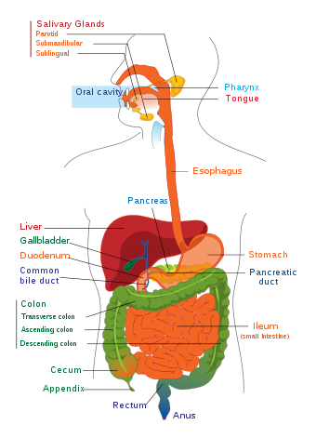
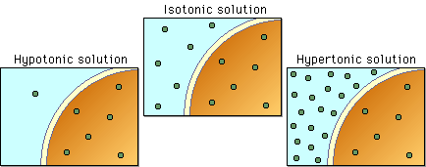
The Science of Isotonix
TM
Everything you eat and drink must be made isotonic before passing into your small intestine
“Isotonic” → same fluid pressure as bodily fluids
COPYRIGHT2018 MASG. ALL RIGHTS RESERVED.
Notes:
Everything you eat and drink, including nutritional supplements, must be made isotonic before passing into your small intestine where it can be absorbed.
"Isotonic" means having the same fluid pressure as your other bodily fluids.

Slide 6
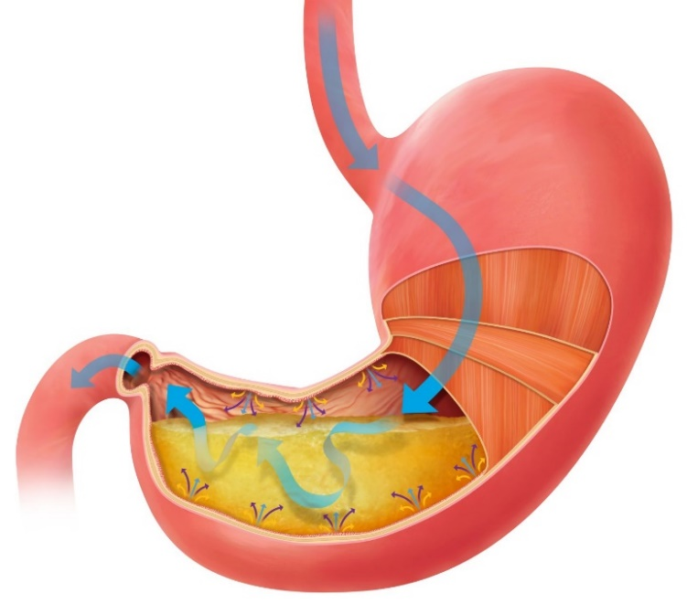
The Science of Isotonix
TM
IsotonixTM products
→ They are isotonic the moment they enter your body
When properly mixed with water + Taken on an empty stomach
→ Isotonic solution flows into your small intestine effectively
COPYRIGHT2018 MASG. ALL RIGHTS RESERVED.
Notes:
Isotonix products are scientifically formulated to ensure that they are isotonic the moment they enter your body.
When properly mixed with water and taken on an empty stomach, the isotonic solution flows into your small intestine effectively.

Slide 7
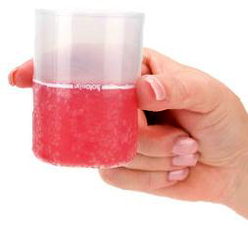
easy to swallow
better absorption
concentrated nutrients
Isotonic
liquid is …
COPYRIGHT2018 MASG. ALL RIGHTS RESERVED.

Slide 8
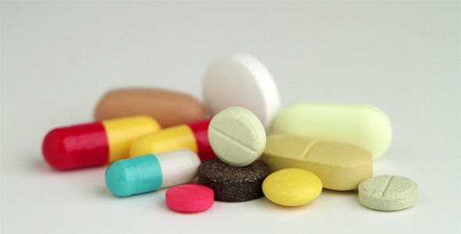
Isotonic VS
capsules
& tablets
Most commercial tablet and capsule supplements
have poor absorption rates.
These pills are exposed to stomach acids and enzymes
before they reach the intestines.
Notes:
Couple that with the fact that most commercial tablet and capsule vitamins have poor absorption rates. (bedpan bullets)
Even the vitamin pills that do breakdown, are exposed to 40 minutes to 4 hours of bombardment by stomach acids and enzymes before they ever reach the absorption site in the intestines. In the process most of the nutrient content is destroyed.

Slide 9
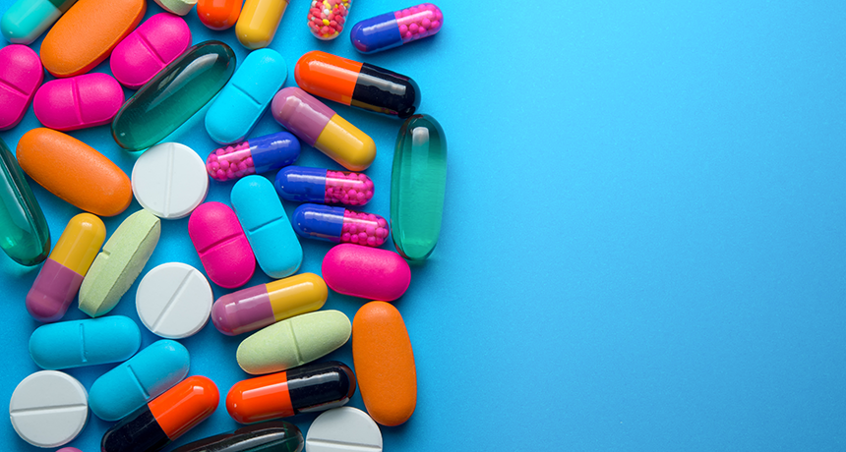
Pill may not completely dissolve before moving into intestinal tract.
Pill may get caught in the folds of the stomach.
Pill dissolves but the water taken with it makes the stomach dump contents and absorption sites become saturated.
Disadvantages of pill delivery
D.Y. Graham et al What Happens to Tablets and Capsules in the Stomach…J. Pharm. Sci. 1990, Vol. 79, No. 5 pp 420 - 424
Notes:
This brings us to Isotonix Advantage #1. Isotonix products move out of the stomach at an optimal rate to maximize absorption.
It’s fast, but controlled; allowing your body’s transport mechanism to efficiently shuttle vitamins into the blood stream.
So let’s look at how Isotonix does this.

Slide 10
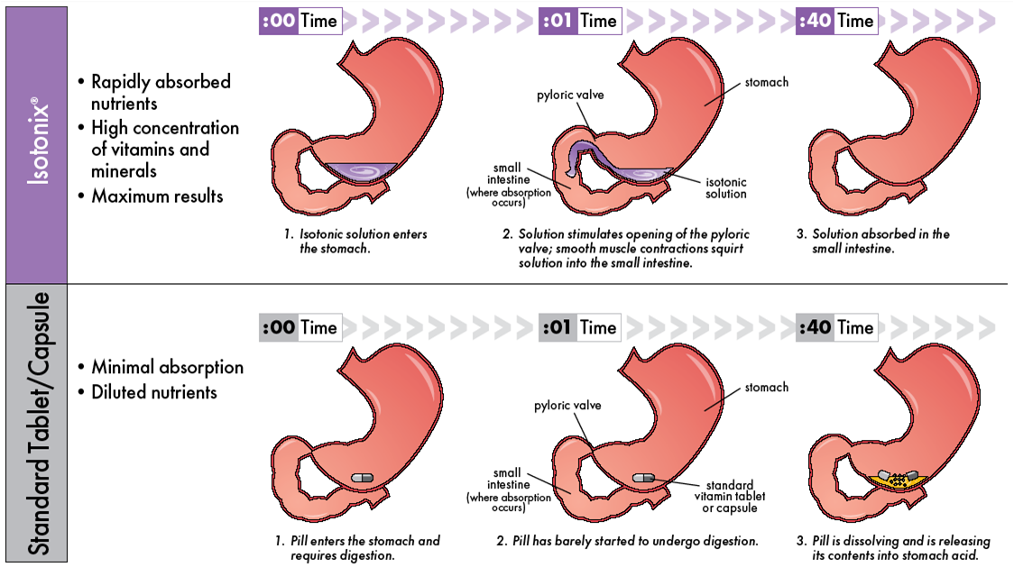
Rapidly absorbed
by the body
High concentration of vitamins and minerals
IsotonixTM
Desirable results
Minimal absorption
Diluted Nutrients
tablet/ capsule/ softgel
COPYRIGHT2018 MASG. ALL RIGHTS RESERVED.
Notes:
Isotonix products are carefully formulated using the right ratio of sugars in the right amounts. Because Isotonix empty from the stomach in a controlled fashion, the absorption sites and carriers are not saturated. This promotes maximum absorption.
Isotonix products are formulated with the proper balance of fructose, d-glucose, citric acid, potassium bicarbonate and other key ingredients to assure that they are isotonic when properly prepared.
Nutrients that are already isotonic do not need to be broken down into an isotonic state.
Gastric emptying occurs more rapidly.
Biological sensors in the gastrointestinal tract detect that the ingested solution is isotonic and at a correct pH.
This causes the pyloric valve at the lower end of the stomach to remain open, allowing the concentrated solution to be squirted into the small intestine by stomach contractions.

Slide 11
Use of Isotonic solution increases
antioxidant biological availability
3
Increased of antioxidant
impact rate
Units / Minute
–––––
2
opc-3™
isotonic
1
opc-3™
as tablet
0
10
20
30
40
50
60
70
80
90
2
2½
3
3½
4
Min
Min
Min
Min
Min
Min
Min
Min
Min
Hour
Hour
Hour
Hour
Hour
Source: http://www.ncbi.nlm.nih.gov/pubmed/19172583
COPYRIGHT2018 MASG. ALL RIGHTS RESERVED.

Slide 12
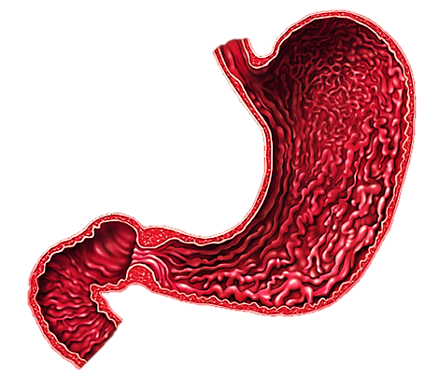
The careful formulation of Isotonix clears the stomach at an optimal, regulated rate to maximise absorption without saturation
It allows your body’s own transport mechanisms to efficiently shuttle vitamins into the blood stream quickly
Digestion
• Hydrochloric Acid
• Water
• Enzymes
• Pepsin
• Intrinsic Factor
Isotonix products are buffered to protect nutrients from Hydrochloric Acid degradation in the stomach
–––––––––––
The Isotonix Advantage
TM
COPYRIGHT2018 MASG. ALL RIGHTS RESERVED.

Slide 13
Carbon dioxide created by the effervescent reaction momentarily reduces the thickness and viscosity of the mucus layer of the intestinal tract, promoting absorption into the bloodstream.
Isotonix products deliver the same concentration of particles as found in the body improving absorption of active ingredients.
Isotonix solutions are gentle on your system because they simulate body fluid.
Isotonix offers an alternative to pills & tablets
Research has shown that
Unlike pills and tablets, Isotonix® has no fillers or binders for the body to remove
40%
of adults have experienced difficulty swallowing pills
The Isotonix Advantage
TM
Pharm. Res. 1998, vol 15, pp 925-930. “Mechanistic studies on effervescent-induced permeability enhancement.”
The survey conducted consisted of 679 adults (513 ages 18-64, 166 age 65 and older) and was funded by the US affiliate of Germany's Schwarz Pharma.
COPYRIGHT2018 MASG. ALL RIGHTS RESERVED.
Notes:
Many elderly have difficulty swallowing pills
The isotonix delivery system is a superior delivery system compared to pills

Slide 14
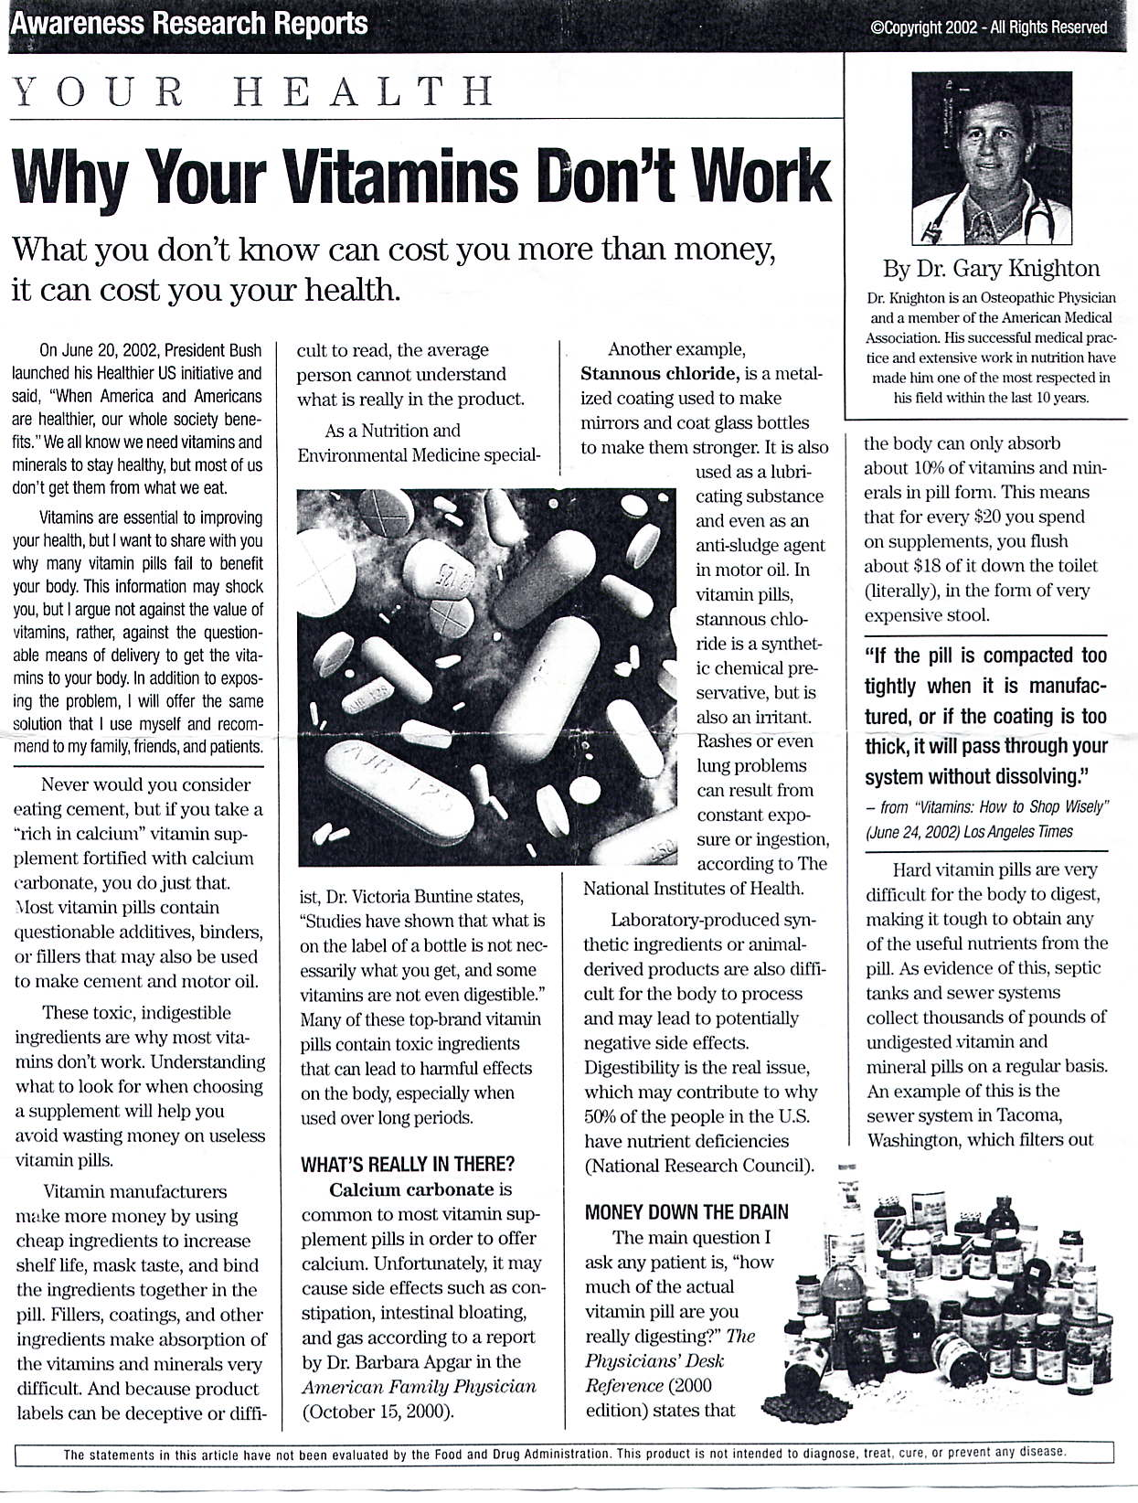
COPYRIGHT2018 MASG. ALL RIGHTS RESERVED.
Notes:
The binders, fillers and coating of pills can greatly interfere with the digestion and absorption of the vitamins & minerals. Also presence of toxic ingredients in the pills.
In USA, sewages have been found to be clogged up by pills!

Slide 15
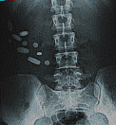
Notes:
For those who may need further explanation, lets take a look at this x-ray taken with pills that did not dissolve. The nutrients in these pills are not been absorbed into the bloodstream.

Slide 16
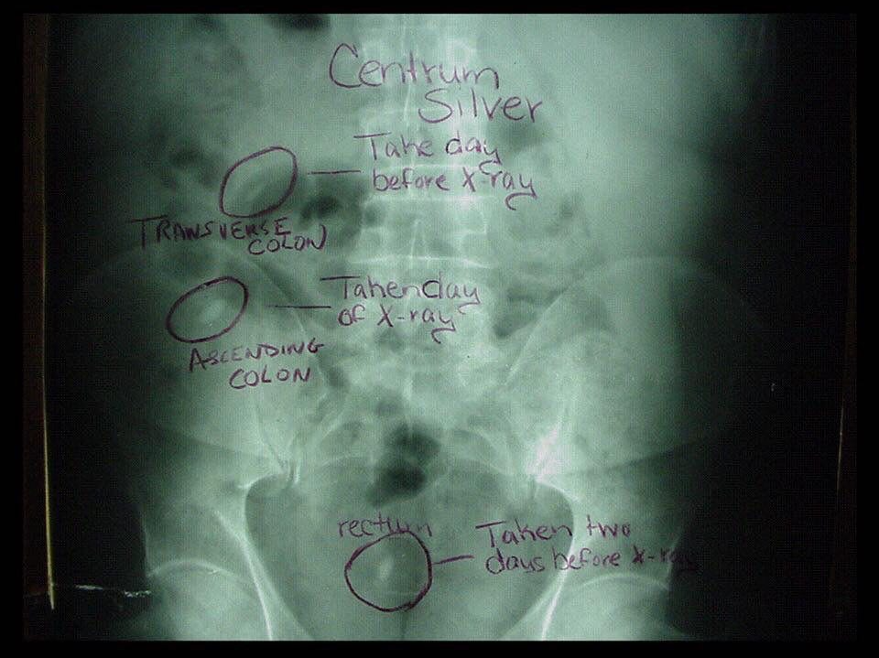

Slide 17
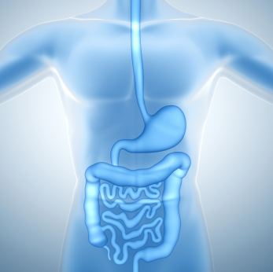
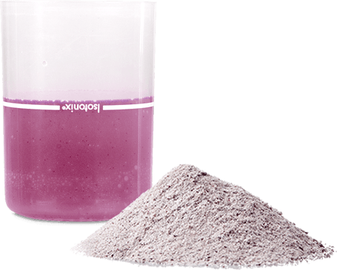
What to consider when choosing nutritional supplementation?
Efficient delivery system (good bioavailability)
Comprehensive and synergistic formulations
Taste and palatability
Scientifically based
High standards for quality control (QC)
COPYRIGHT2018 MASG. ALL RIGHTS RESERVED.

Slide 18
we are what we
absorb

